Slide 1

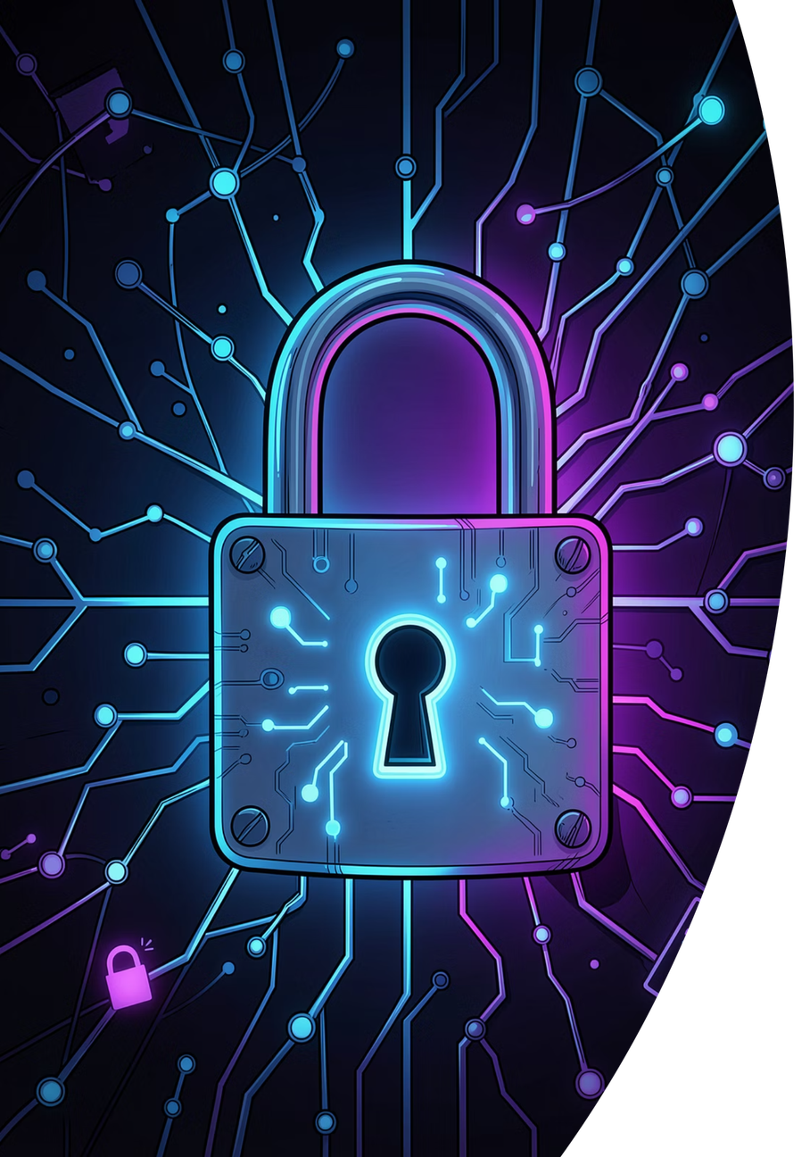
Phishing Awareness Training
Understanding and Preventing Phishing Attacks
CYBERSECURITY TRAINING
Notes:
1

Slide 2

Introduction to Phishing
What is Phishing?
Why It's a Major Threat
Phishing is a type of cyberattack where malicious actors disguise themselves as trustworthy entities to trick individuals into revealing sensitive information such as passwords, credit card numbers, or personal data. These attacks are typically carried out through deceptive emails, messages, or websites.
Phishing remains one of the most prevalent and dangerous cybersecurity threats facing individuals and organizations today. It exploits human psychology rather than technical vulnerabilities, making it difficult to defend against with technology alone. Billions of phishing emails are sent every day, and a single successful attack can lead to devastating data breaches, financial loss, and reputational damage.
Phishing attacks account for over 80% of reported security incidents globally. Human awareness is the first and most critical line of defense.
Notes:
2

Slide 3










Types of Phishing Attacks
Phishing comes in many forms, each targeting victims through different channels and with varying levels of sophistication. Understanding the different types is the first step to recognizing them.
Email Phishing
Spear Phishing
Whaling
Mass emails sent to thousands of recipients impersonating legitimate organizations like banks, tech companies, or government agencies.
Highly targeted attacks directed at specific individuals or organizations, using personalized information to appear more convincing.
A form of spear phishing that specifically targets high-profile executives, CEOs, or other senior leaders within an organization.
Smishing
Vishing
Phishing conducted via SMS text messages, often containing malicious links or prompts to call fraudulent phone numbers.
Voice phishing carried out over phone calls, where attackers impersonate bank representatives, tech support, or government officials.
Notes:
3

Slide 4

How Phishing Works
Understanding the anatomy of a phishing attack helps you recognize and stop it at every stage. Attackers follow a predictable pattern designed to exploit trust and urgency.
Fake Message
Malicious Click
Data Theft
Each stage of a phishing attack is carefully engineered to bypass your suspicion. The attacker invests time in making the message look authentic — using real logos, familiar language, and spoofed email addresses. Once the victim engages, the damage can happen in seconds.
Notes:
4

Slide 5


Common Signs of Phishing Emails
Learning to spot the warning signs of a phishing email is one of the most powerful defenses you have. Always pause and inspect before you click.
🔍 Suspicious Sender Address
⚠️ Urgent or Threatening Language
✏️ Spelling and Grammar Mistakes
The "From" address may look legitimate at first glance but contains subtle misspellings or uses a free email domain (e.g., support@paypa1.com or noreply@google-support.net).
Phrases like "Your account will be suspended in 24 hours!" or "Immediate action required!" are designed to panic you into acting without thinking.
Legitimate organizations proofread their communications. Unusual phrasing, awkward grammar, or obvious typos are red flags that the message may not be genuine.
📎 Unexpected Attachments
🔗 Fake or Misleading Links
Unsolicited attachments — especially .exe, .zip, or Office files with macros — can contain malware. Never open attachments you weren't expecting.
Hover over any link before clicking. The displayed text may say "www.yourbank.com" but the actual URL destination could be a completely different malicious site.
Notes:
5

Slide 6
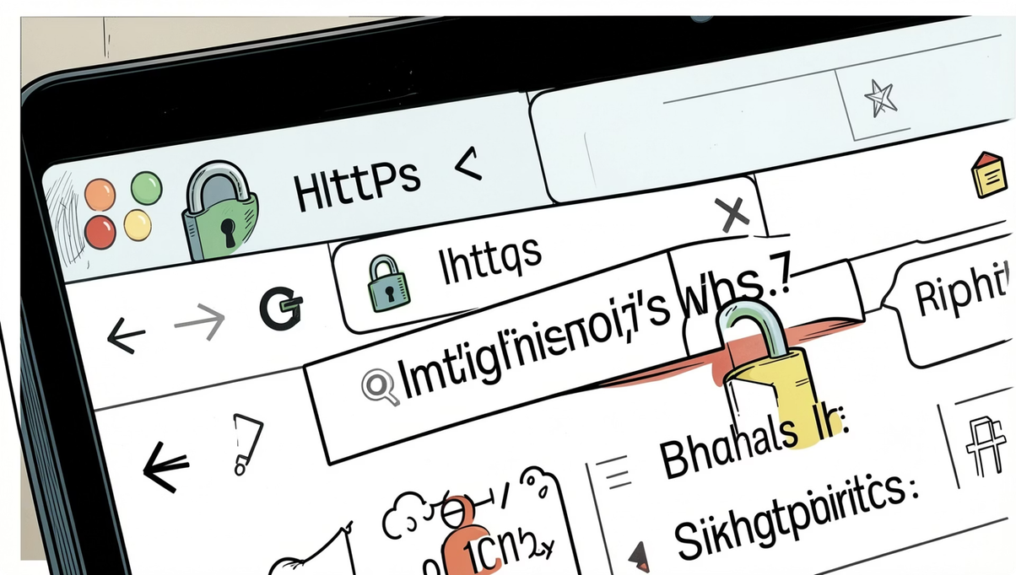

Fake Website Detection
How to Spot a Fake Website
Phishing attacks often direct victims to convincing fake websites designed to harvest login credentials. Knowing what to look for can save you from falling victim.
1
Check the URL Carefully
2
Verify HTTPS
3
Look for Domain Spelling Errors
Always examine the full URL in the address bar. Attackers use tricks like substituting letters (e.g., "rn" for "m"), adding extra words (e.g., "secure-paypal-login.com"), or using different top-level domains.
While HTTPS indicates an encrypted connection, it does NOT guarantee a site is legitimate. Phishing sites can and do use HTTPS. Always verify the full domain, not just the padlock icon.
Watch for subtle misspellings in the domain name such as "arnazon.com" instead of "amazon.com" or "micros0ft.com" instead of "microsoft.com".
Notes:
6

Slide 7

Social Engineering Techniques
Phishing attacks succeed not because of technical exploits, but because they manipulate human psychology. Attackers are skilled at exploiting emotions and cognitive biases.
🎭 Impersonation
😨 Fear Tactics
Attackers pose as trusted figures — your bank, your IT department, a colleague, or even your CEO. The more convincing the persona, the more likely you are to comply with their requests.
Messages that threaten account suspension, legal action, or financial penalties are designed to override rational thinking and push victims into hasty decisions.
⏰ Urgency
🎁 Rewards and Prizes
Creating artificial time pressure ("You have 2 hours to respond!") prevents victims from pausing to verify the legitimacy of the request or consulting with others.
Promises of gift cards, lottery winnings, or exclusive offers exploit greed and excitement. If it sounds too good to be true, it almost certainly is a scam.
The best defense against social engineering is to slow down, verify independently, and never let emotion drive your security decisions.
Notes:
7

Slide 8
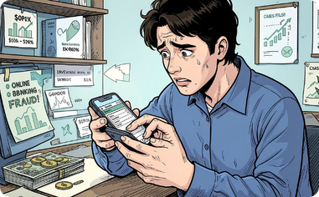
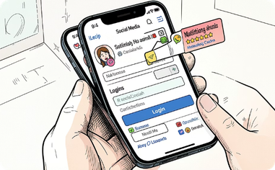

Real-World Phishing Examples
Phishing attacks happen across every industry and platform. These real-world scenarios illustrate how attackers exploit familiar contexts to deceive victims.
Banking Scams
Social Media Scams
Fake Job Offers
Victims receive emails appearing to be from their bank, warning of suspicious activity and urging them to "verify" their account by clicking a link. The fake login page captures their credentials, giving attackers full access to their accounts.
Fake notifications from platforms like Facebook, Instagram, or LinkedIn claim that your account has been compromised or that you've been tagged in a post. Clicking the link leads to a credential-harvesting page designed to look identical to the real platform.
Fraudulent recruiters send enticing job offers via email or LinkedIn, asking candidates to fill out forms with personal information, submit copies of ID documents, or even pay upfront fees for "background checks" — all of which are used for identity theft or fraud.
Notes:
8

Slide 9




Best Practices to Stay Safe
Protecting yourself from phishing requires consistent habits and a security-first mindset. Follow these best practices every day to significantly reduce your risk.
Do Not Click Unknown Links
Verify Sender Identity
Hover over links to preview the destination URL before clicking. When in doubt, navigate directly to the website by typing the address into your browser rather than following a link in an email or message.
Before responding to any email or message requesting sensitive information, independently verify the sender's identity by contacting them through a known, trusted channel — not the contact details provided in the suspicious message.
Enable MFA / 2FA
Use Strong, Unique Passwords
Multi-Factor Authentication (MFA) or Two-Factor Authentication (2FA) adds a critical second layer of security. Even if an attacker obtains your password, they cannot access your account without the second verification factor.
Use a different strong password for every account. A password manager can help you generate and store complex passwords securely, so you never have to reuse credentials across multiple sites.
Notes:
9

Slide 10


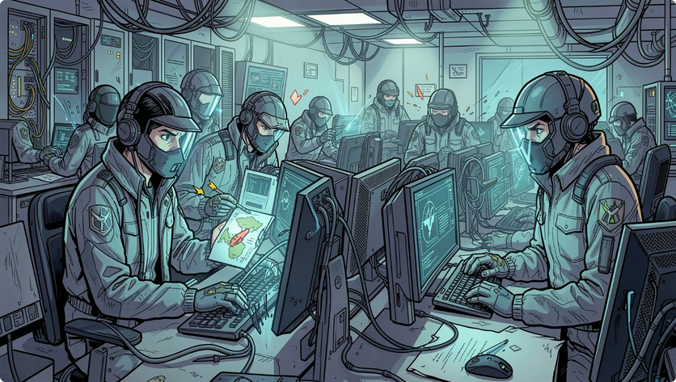

What To Do If You've Been Phished
Acting quickly and decisively after a phishing incident can significantly limit the damage. If you suspect you've fallen victim to a phishing attack, follow these steps immediately.
1
Change Passwords Immediately
Change the passwords for any accounts that may have been compromised. Start with your email account, then banking and financial accounts, then any other services where you use the same credentials.
2
Report the Incident
Report the phishing attempt to your organization's IT or security team right away. Also report it to the impersonated company and to relevant authorities such as the Anti-Phishing Working Group (APWG) or your national cybercrime reporting center.
3
Scan Device for Malware
Run a full antivirus and anti-malware scan on your device immediately. If you clicked a link or opened an attachment, malicious software may have been installed without your knowledge.
4
Time is critical after a phishing incident. Every minute of delay increases the potential damage. Do not wait — act immediately and report without hesitation.
Notify Your Organization
If the incident occurred on a work device or involved company accounts, notify your IT security team and management immediately. Early notification allows the organization to contain the breach and protect other employees from follow-on attacks.
Notes:
10

